Slide 1

Proteomics Quantification: iTRAQ

Slide 2
Introduction
ITRAQ is an acronym of Isobaric tag for relative and absolute quantitation.
ITRAQ was developed by Applied Biosystems Incorporation in 2004.
ITRAQ is a isobaric labeling method to determine the amount of proteins3from different sources in just one single experiment.

Slide 3
Th e Principle and workflow of iTraq
The structure of ITRAQ reagents The isobaric tagging reagents consist of a unique charged reporter group, a peptide reactive group, and a neutral balance group.
The peptide reactive group covalently links an ITRAQ Reagent isobaric tag with each lysine side chain and N-terminus group of a peptide, labeling all peptides in a given sample digest.
The neutral balance group ensures the ITRAQ labeled-peptide displays the same mass to maintain an overall mass of 145 Da for 4-plex and 305 Da for 8-plex.

Slide 4
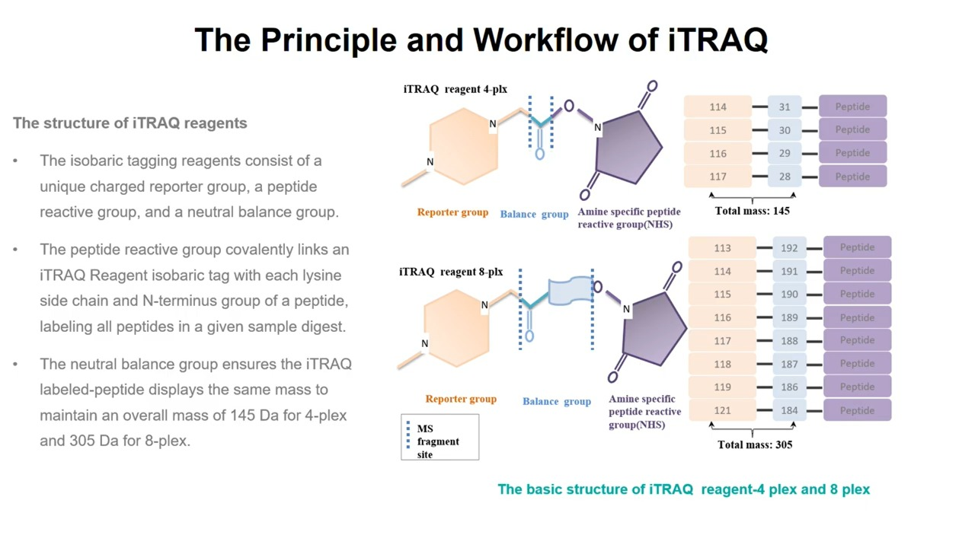
Th e Principle and workflow of iTraq

Slide 5
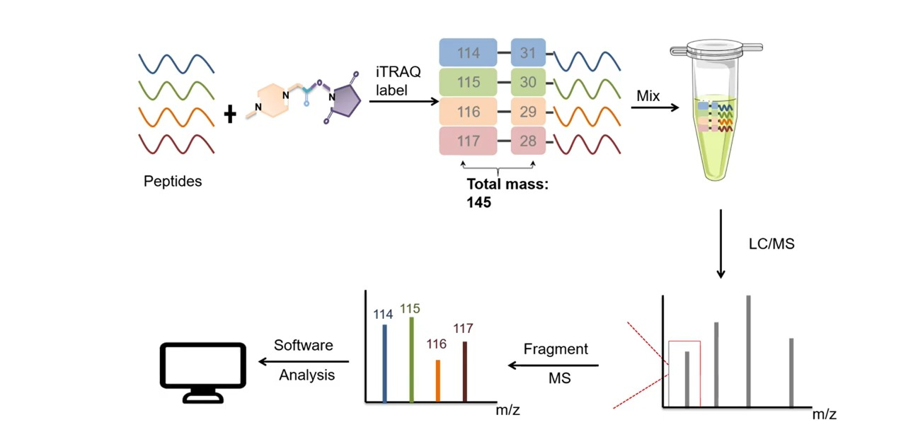
Principle of iTraq reagent 4-plex as an example

Slide 6
Factors affecting results of iTRAQ
Evaluation of labeling efficiency and isotope impurity correction
Ratio compression and its correction
Reporter ion intensity dynamic range
Effect of unique and shared peptides in inferring protein ratios
Estimation of protein fold changes
Comparison of multiple isobaric labeling experiments

Slide 7
Advantages
Using mass spectrometry
Ability to analyze from cell tissues or serum
Multiplexing ability
Reduce overall variation

Slide 8
disadvantages
Costly
Very sensitive to contamination from salts
A requirement of sophisticated software
Variability arising due to the inefficient anzymatic digestion

Slide 9
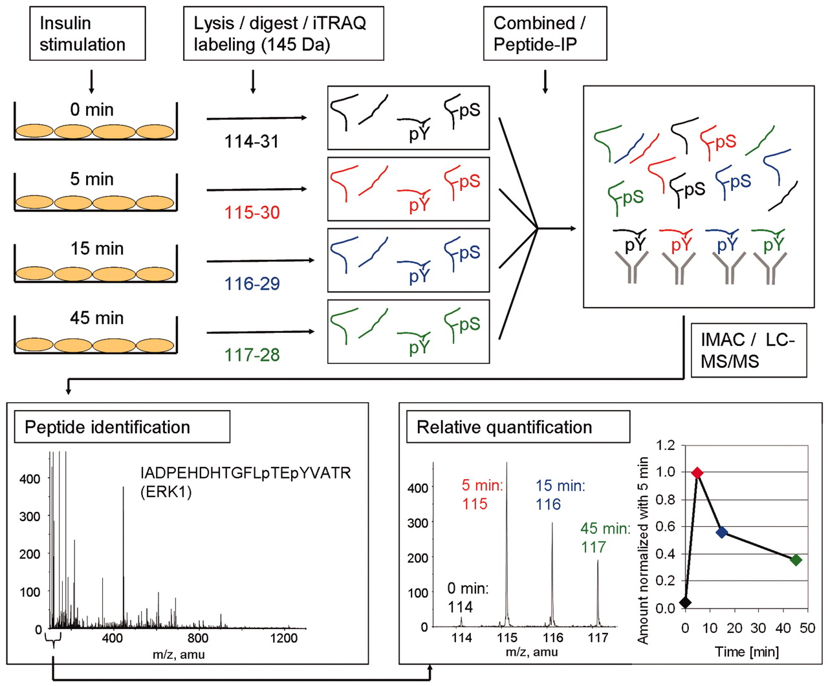
An Example
ITRAQ used to identify and quantify tyrosine phosphorylation sites upon insulin stimulation.

Slide 10
THANKS!

